Slide 1
Visitor Pattern
Eating candy efficiently
By Andrew Fasano and Michael Chan

Slide 2
Presentation Plan
A candy problem
Eating candy without the visitor pattern
Eating candy with the visitor pattern
Working with new types of candy
Benefits and drawbacks to the visitor pattern

Slide 3
Sample Problem
Two classes of data:
Snickers and Lollipops
Both are stored as a subclass of Candy

Slide 4
Eating Our Candy
Since Snickers and Lollipops are different types of candy, we need different code telling us how to eat each kind.
How do you eat them?

Slide 5
How to Eat?
Method 1:
For Snickers
Open and Chew!
Method 2:
For Lollipops
Unwrap and Lick!

Slide 6
Possible Solution
Create an Eat function in each sub-class
class Snickers inherits Candy
function eat() { open(); chew(); enjoy();}
end
class Lollipop inherits Candy
function eat() { unwrap(); lick(); enjoy();}
end

Slide 7
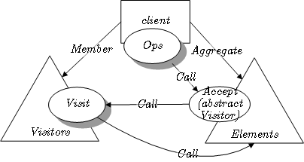
But I Don't Want to Write that much code!
Use a Visitor Pattern!

Slide 8
A Better Solution
function eat(candy C)
if c.type is Snickers
//Open and Chew
Eating_Method_1(C);
if c.type is Lollipop
//Unwrap and Lick
Eating_Method_2(C);
end

Slide 9
An Even Better Solution
Various eat functions in the Visitor Class identify the type of each object and decides whether the Candy should be eaten with
Eating Method 1 or Eating Method 2

Slide 10
A Better Solution
This approach allows the user to eat more efficiently by only checking the eating input through the singular function
eat

Slide 11
Pseudo Code
class Visitor
eat (Snickers S)
open(); chew(); enjoy();
eat (Lollipop L)
unwrap(); lick(); chew(); enjoy();

Slide 12
C++ Example
Available at
AndrewFasano.com/sdd.tar

Slide 13
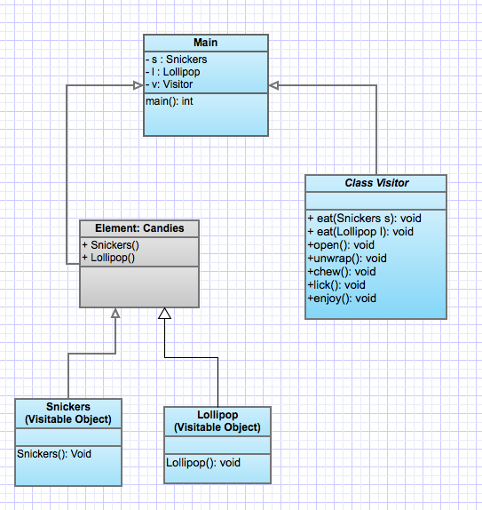
UML Diagram

Slide 14
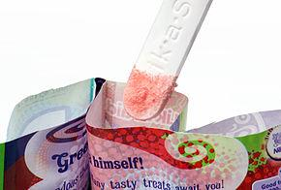
Your turn
How would we add a class for Fun Dip with and without using the visitor pattern?

Slide 15
Solution
Using the visitor pattern
Add this code to Visitor class
function eat(FunDip F)
open(); dip(); lick(); enjoy();

Slide 16
Solution
Not using the visitor pattern
Add this code to the class
class Fun Dip inherits Candy
function eat() { open(); dip(); lick(); enjoy();}
end

Slide 17
Benefits
All code for eat functions is in the same place
They can all access the same helper functions.
Not separated into multiple classes.
Requires less code
No conditional logic needed for visitor pattern
Adding new new functions is easier
Just adding similar code into the same file

Slide 18
Drawbacks
Every possible argument and return type must be defined in visitor class
May have to reuse nearly identical code
Code is slightly obfuscated
Code is separated from class which may confuse
Must be used in initial development
Porting code to the visitor pattern is difficult

Slide 19
Sources
Mauer, George. "When Should I Use a Visitor Design Pattern." Web log post.StackFlow. N.p., 21 Oct. 2008. Web. 2 Oct. 2012. <http://stackoverflow.com/questions/255214/when-should-i-use-the-visitor-design-pattern>.
"Visitor Pattern." Wikipedia. Wikimedia Foundation, 10 Sept. 2012. Web. 02 Oct. 2012. <http://en.wikipedia.org/wiki/Visitor_pattern>.
"Visitor Pattern Versus Multimethods." Visitor Pattern Considered Useless. N.p., n.d. Web. 09 Oct. 2012. <http://nice.sourceforge.net/visitor.html>.
"Be Not Afraid of the Visitor, the Big, Bad Composite, or Their Little Friend Double Dispatch." Stuff You Need to Code Better! N.p., n.d. Web. 09 Oct. 2012. <http://codebetter.com/jeremymiller/2007/10/31/be-not-afraid-of-the-visitor-the-big-bad-composite-or-their-little-friend-double-dispatch/>.
"Visitor Pattern." OOODesign. OOODesign, n.d. Web. 2 Oct. 2012. <http://www.oodesign.com/visitor-pattern.html>.
"Visitor Design Pattern." Visitor Design Pattern. N.p., n.d. Web. 09 Oct. 2012. <http://sourcemaking.com/design_patterns/visitor>.
Sources

Slide 20
Questions?
Ask something and get candy!

